Slide 1

第三週 超啟發式演算法
2/24
Notes:
1
1

Slide 2

大綱
上週
Tabu Search(TS)
2
Notes:
2
2

Slide 3
TED(1/3)
Run:整個程式要跑幾遍,為求實驗數據之公平.
Iteration: TED要跑幾個遍.
Objective Function:目標函數,看問題而有不同的定義,演算法目的都是去求此方程式最佳化的值.
Objective Value: Objective Function所產生之值,用來衡量此解在解空間的好壞.
Transition( ):扮演著在解空間,開始搜索的腳色.
Evaluation( ):衡量transition過後,此解之objective value.
Determination( ):決定是否比目前最佳值好,如果有則將此解當作目前最佳解.
3
Notes:
3
3

Slide 4
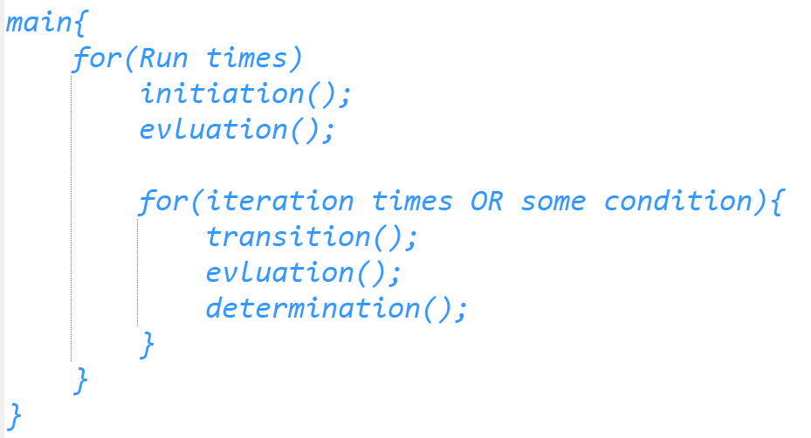
TED(2/3)
4
Notes:
4
4

Slide 5
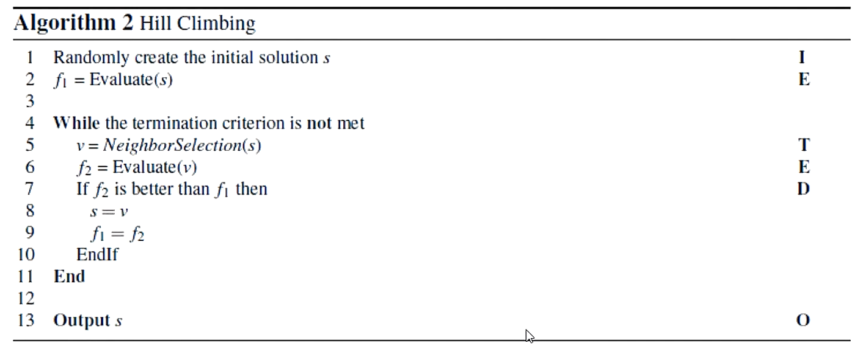
TED(3/3)
5
Notes:
5
5

Slide 6
簡介之後會學的演算法
Single-solution-based algorithms work on a single solution:
Hill Climbing (HC)
Simulated Annealing (SA)
Tabu Search (TS)
Population-solution-based algorithms work on a population of solution:
Genetic Algorithm (GA)
Ant Colony Optimization (ACO)
Particle Swarm Optimization (PSO)
6
Notes:
6
6

Slide 7
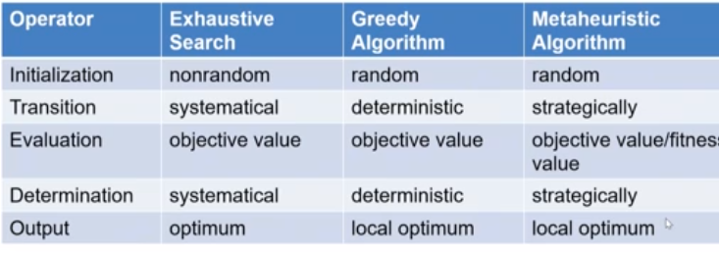
簡介之後會學的演算法
7
Notes:
7
7

Slide 8
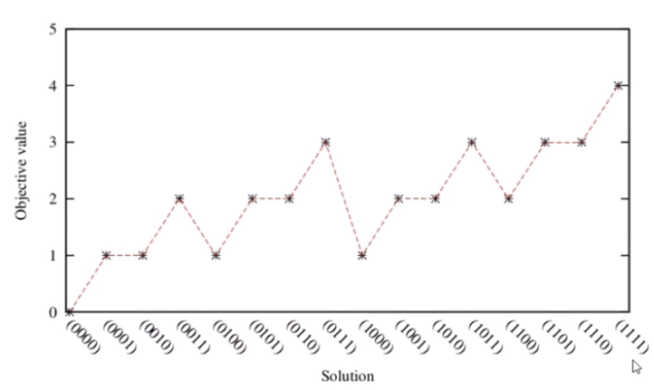
Simulate Anneal(SA)
8
Notes:
8
8

Slide 9
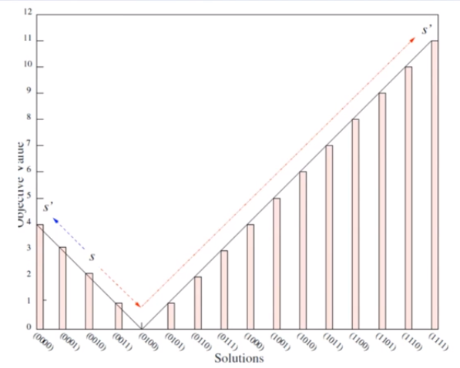
Simulate Anneal(SA)
Simulation Anneal (SA) :模擬退火,解決傳統ES HC之困境.
偶爾接受沒進步的的解,所以不會永遠朝會獲得更好方向的解空間前進.
9
Notes:
9
9

Slide 10
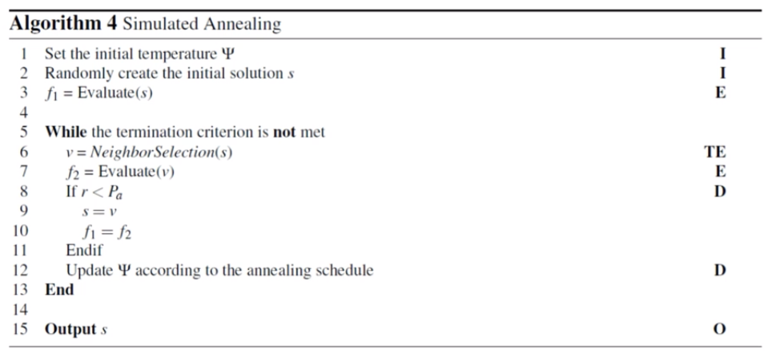
Simulate Anneal(SA)
10
Notes:
10
10

Slide 11

Simulate Anneal(SA)
為了去模擬退火的過程, 所以要去計算接受較差解的機率.
exp(x)：傳回自然對數e之x次方值.
V: new solution
S:current solution
: temperature
而比較的對象為 r ,每次都隨機設定為1~0之間的小數
11
Notes:
11
11

Slide 12


Simulate Anneal(SA)
SA中,會有三種可能:
1.new solution V is better than current solution S , SA will always accept V.(Because will greater than 1.)
2.new solution V is worse than current solution S, SA will accept V only if
> r
3.new solution V is worse than current solution S , SA will not accept V if
< r.
:
隨著每個iteration , 溫度都應該漸漸下降(why?)
12
Notes:
12
12

Slide 13
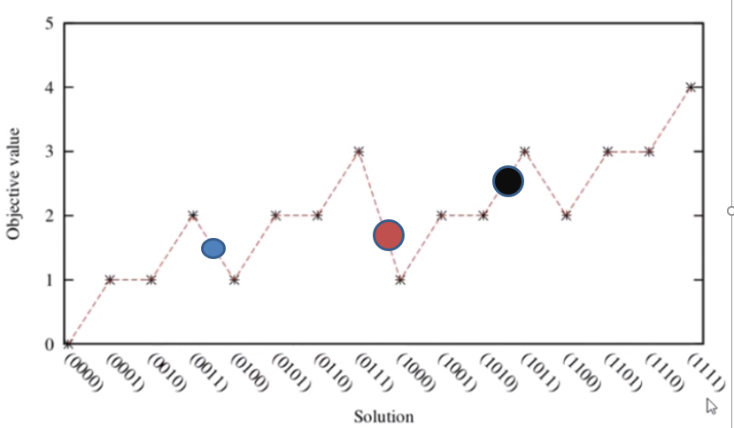
Simulate Anneal(SA)
13
Notes:
13
13

Slide 14
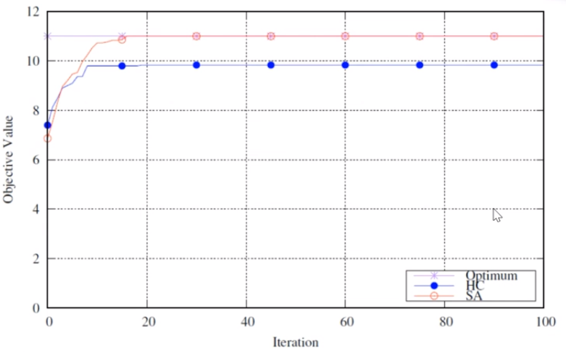
Simulate Anneal(SA)
14
Notes:
14
14

Slide 15
作業
One max problem版本之SA(100bit):
要求如下:
盡量寫成TED格式. (提醒FUNCTION 名字)
盡量不要將bit number寫死.
顯示每個iteration之結果.
寫一個txt檔,紀錄跑1000個iteration後, 所找到的最佳值和其模樣.
作業有無問題,我的CODE
15
Notes:
15
15

Slide 16
Tabu Search
Tabu Search(TS): 禁忌搜尋.
The basic idea of TS is to avoid searching the same solution too frequently
The search process of TS will keep track of solution visited recently, by storing them in a queue (called tabu list) to avoid the later search process from searching for the same candidate solution again and again.
16
Notes:
16
16

Slide 17
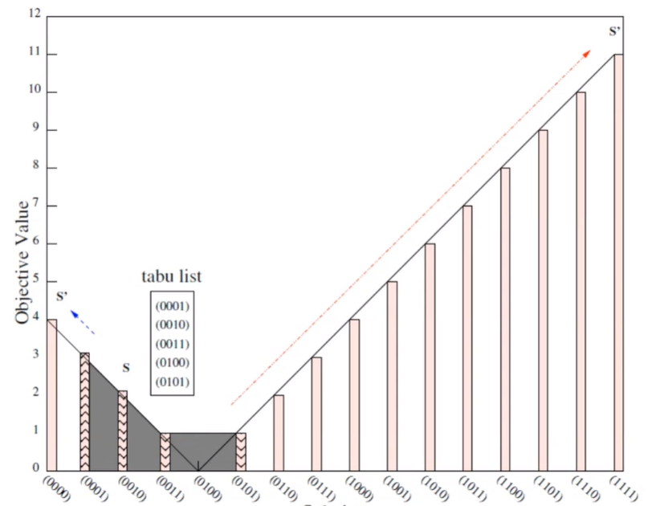
Tabu Search
17
Notes:
17
17

Slide 18
Tabu Search
18
Notes:
18
18

Slide 19
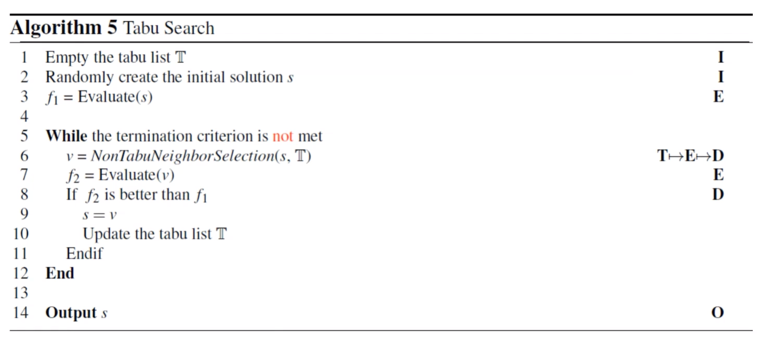
Tabu Search
19
Notes:
19
19

Slide 20
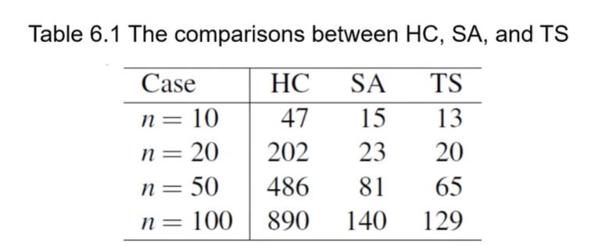
Tabu Search
Tabu List: queue structure.
20
Notes:
20
20

Slide 21
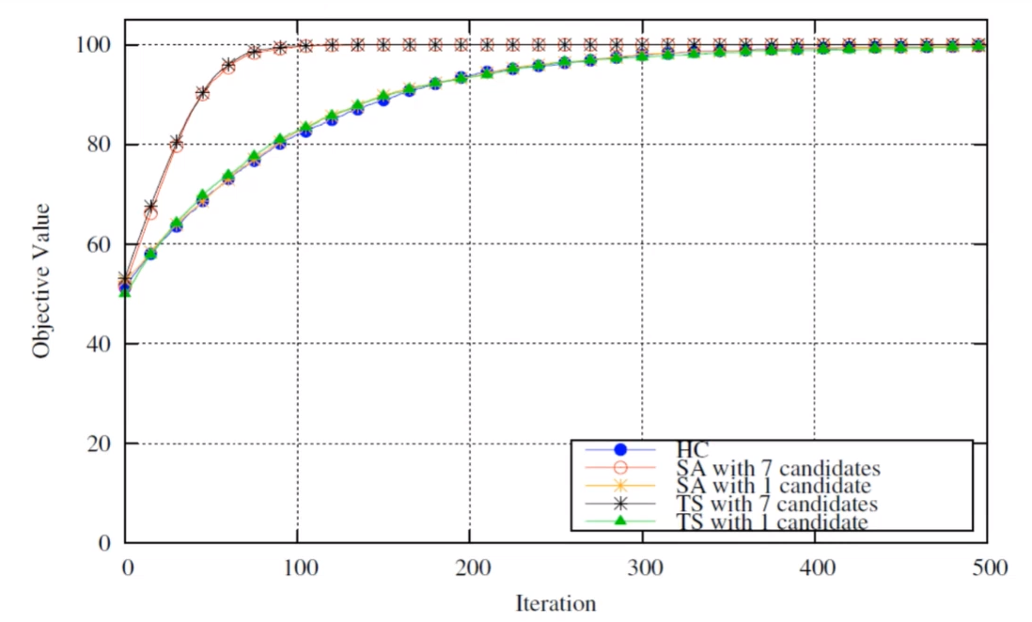
Tabu Search
21
Notes:
21
21

Slide 22
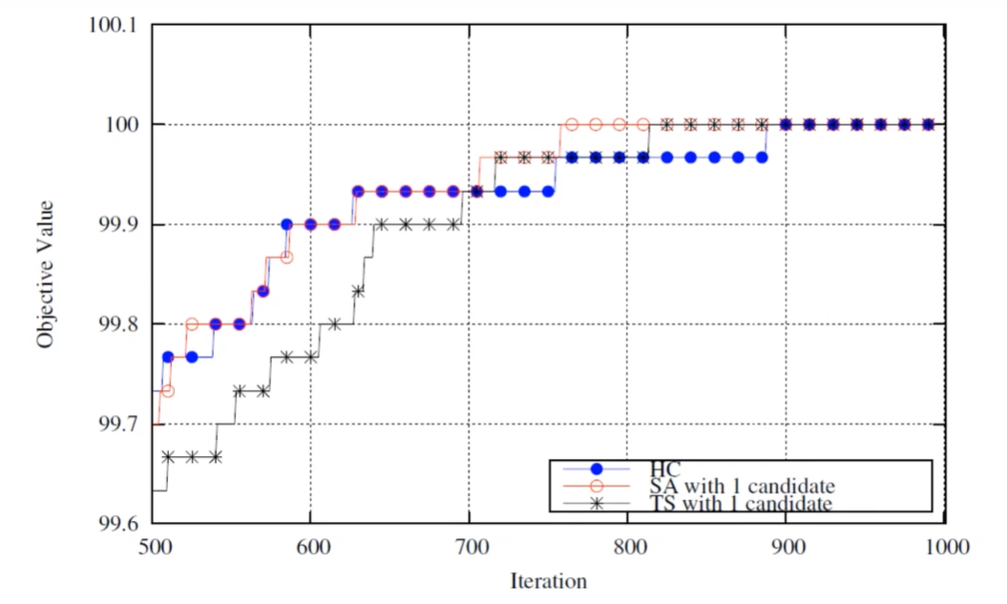
Tabu Search
22
Notes:
22
22

Slide 23
作業
寫一個txt檔案,寫出自己覺得HC SA TS的差別 ,字數不用多
寫出100bit的TS, bit不要寫死, 一樣按照TED.
記得自己先把作業存起來暑假會用到.
加油 <3
23
Notes:
23
23

Slide 24
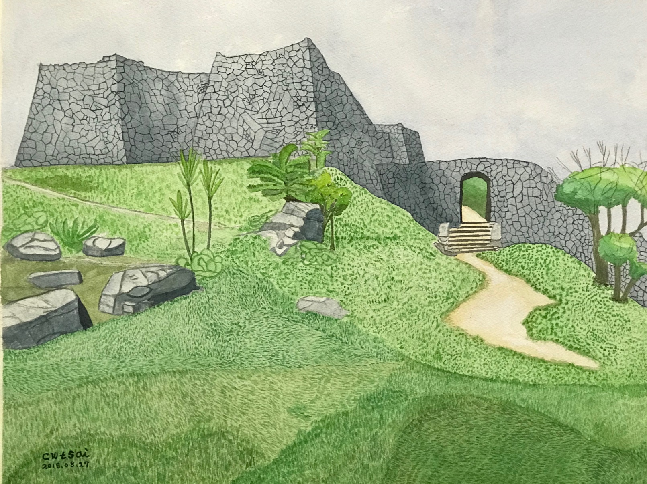

Thank You ;-)
Notes:
24
24

